Slide 1
Ecology vs. the Economy LESSONS FROM PIKETTY’S CAPITAL IN THE 21st CENTURY
Steven Pressman
pressman@monmouth.edu

Slide 2
The Cause of Inequality
Key Equation, Piketty Inequality, r>g
g is the economic growth rate. It depends on
1. Labor Force Growth
2. Productivity Growth
r is the rate of return on wealth, weighted average of:
1. Average Return on Stocks and Bonds (owned by top 1%)
2. Average Interests on Bank Accounts
3. Average Profits on Unincorporated Business
4. Average Increase in Home Values
5. Average Increase in Other Assets

Slide 3
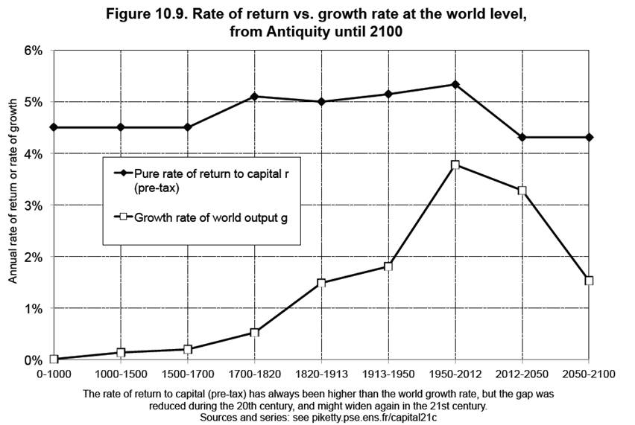

Slide 4
The Power of Compounding
Your Income = $100,000 & Your Wealth = $100,000
Let r=5% & g=0%
After 35 years,
Your Income = $100,000 & Your wealth = $500,000+
After 100 years,
Your Income = $100,000 & Your wealth = $12.5 million.

Slide 5
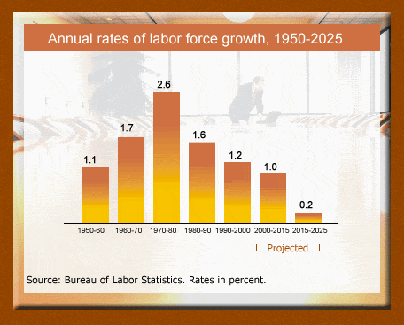

Slide 6
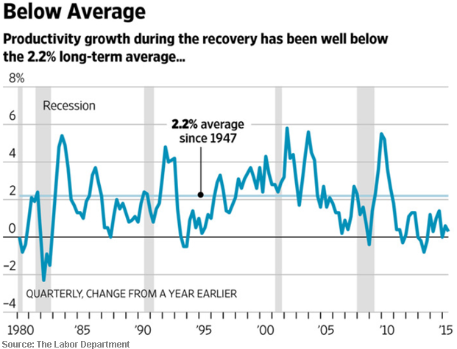

Slide 7
Some Final Thoughts
BIG versus Job Sharing
A paradox– BIG helps the distribution problem, but increases spending & growth
Focus on reducing r, as Piketty argues
Social Security Deficit Problem
SSA 75-yr estimates: 2.66% (mid- 2% growth) & 6.3% (hi cost- 1.4% growth)
Numbers are worse with 0% growth, lower wages, and increased longevity (reduced stress)

Slide 8
Thank you for paying attention!!

